Slide 1
Agile business analysis Sprint 2
David Studer, Laura Seiler & Soyhan Parlar

Slide 2
General Feedback Prototype
How did you like the app?*
4.6
What did you like?
What needs improvement?
“Easy to use”
“I like using intelligence for such a thing”
“The idea is great”
“Design is slick”
“Easy to choose given options”
“Easy usable”
“Catchier layout, would be nice”
“Too many screens to go through”
“Too many clicks”
“Include more swiping than clicking”
“Reduce possible answers to three”
* N=11; Graded with scale of Swiss school system: 1 is worst grade, 4 is sufficient to pass, 6 is best grade

Slide 3
Prototype Design
How did you like the design?*
5
What did you like?
What needs improvement?
“Slick”
“Smartphone optimized”
“Cheerful vibe”
“Simplicity”
“Colour-scheme”
“Question interface A: reduce button size and colour (something less aggressive)”
“Too much blue”
“Too many buttons”
* N=11; Graded with scale of Swiss school system: 1 is worst grade, 4 is sufficient to pass, 6 is best grade

Slide 4
Prototype Questions
How did you like the questions?*
5.3
What did you like?
What needs improvement?
“Perfect mix between private and general one”
“Easy to go through”
“Some where really interesting”
“Easy and quick to answer”
“Short & easy”
“Confusing feedback from design”
“Maybe less answer possibilities”
* N=11; Graded with scale of Swiss school system: 1 is worst grade, 4 is sufficient to pass, 6 is best grade

Slide 5
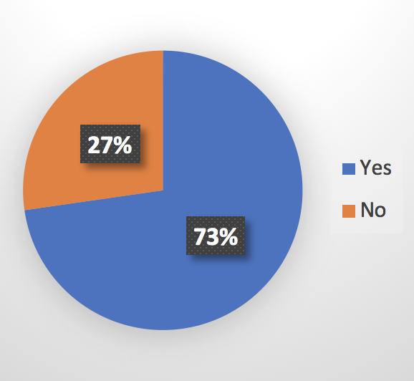
Prototype Purpose
Do you think the app might help your relationship?*
* N=11

Slide 6
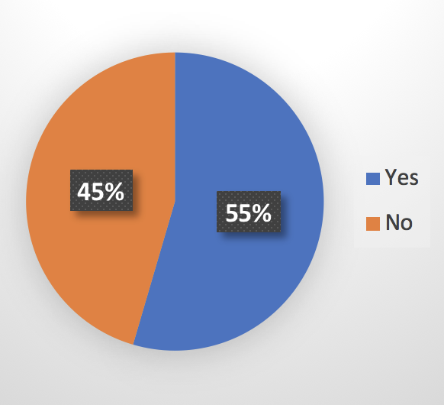
Pricing (I/II)
Would you pay for the app?*
* N=11

Slide 7
Pricing (II/II)
If yes, how much?*
CHF 2.25
If not, why?
“Nothing special in it so far”
“See no need for it”
“Maybe for a premium version”
* N=6

Slide 8
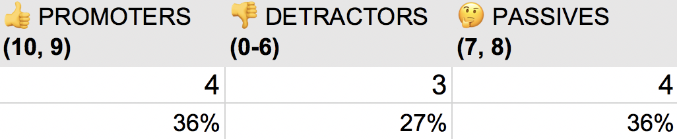
Transactional Net Promoter Score
How likely would you recommend the app to a friend?*
tNPS = +9.1
* N=11

Slide 9
Question Interface – A/B Testing
Which question interface did you like more?* [A = challenger version / B = old version]
100% for challenger version (A)
* N=11

